Slide 1
Analysis on kidney disease (KCD or not KCD)
Analyze by
Usman Ahmad
Hafiz ur Rehman M khubaib M Ali

Slide 2
Outlines
KCD and NOT KCD differentiate .
Data set overview
Aims of data set
Data Exploration & Preprocessing
Handling of numerical and categorical missing value
Outliers and Outliers handling and visual representation of Outliers
Feature Engineering

Slide 3
Continue….
Insights from the Analysis
Final Conclusion
Data Trends & Observations

Slide 4
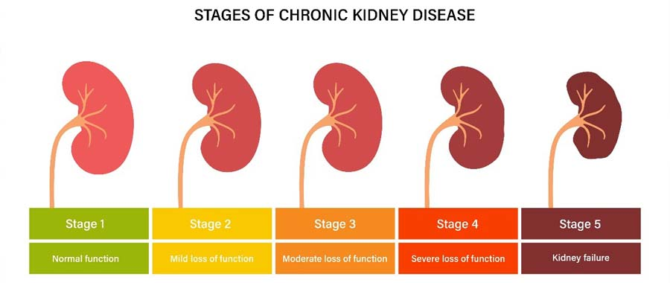
KCD or not KCD

Slide 5
Data set overview
The dataset consists of 400 records with 26 columns, representing various medical parameters of patients. It includes both numerical and categorical features, with some missing values across different columns
Numerical Features (12 columns): Includes attributes like age, blood pressure (bp), specific gravity (sg), hemoglobin (hemo), sodium (sod), potassium (pot), and blood glucose random (bgr). These are mainly stored as float64 data types.

Slide 6
Continue dataset overview
Categorical Features (14 columns): Includes features such as red blood cells (rbc), pus cells (pc), hypertension (htn), diabetes mellitus (dm), coronary artery disease (cad), appetite (appet), and classification (target variable). These are stored as object data types.
Missing Values: Some columns, like rbc (248 non-null) and wc (295 non-null), have significant missing data, which may require handling during preprocessing.

Slide 7
Aims of data set
The dataset is designed for medical analysis and likely aims to predict a disease classification based on various patient attributes
Age BP SG RBC Hemo HTN Classification
45 80 1.02 Normal 13.5 Yes CKD
30 120 1.025 Normal 15.0 No Non-CKD

Slide 8
Data Exploration & Preprocessing
Numerical columns with Missing values bp 12 , sg 47 , al 46 ,su 49 , bar 44 , bu 19 , sc 17, sod 87 , pot 88 , hemo 52 age 9
Missing values in object columns: rbc 152 , pc 65 , pcc 4 , ba 4, pcv 70 , wc 105, rc 130 htn 2 , dm 2 , cad 2 , appet 1 , ane 1 , pe 1

Slide 9
Handling of numerical and categorical missing value
Filling of numerical missing values : missing values are not so large in the data set so I used the mean to fill the missing values .
pandas is used to fill this values
Filling of categorical or object missing values : Here I used the Random forest model which predict the another columns values and fill the that missing values pandas and scikit learn is used to fill this values

Slide 10
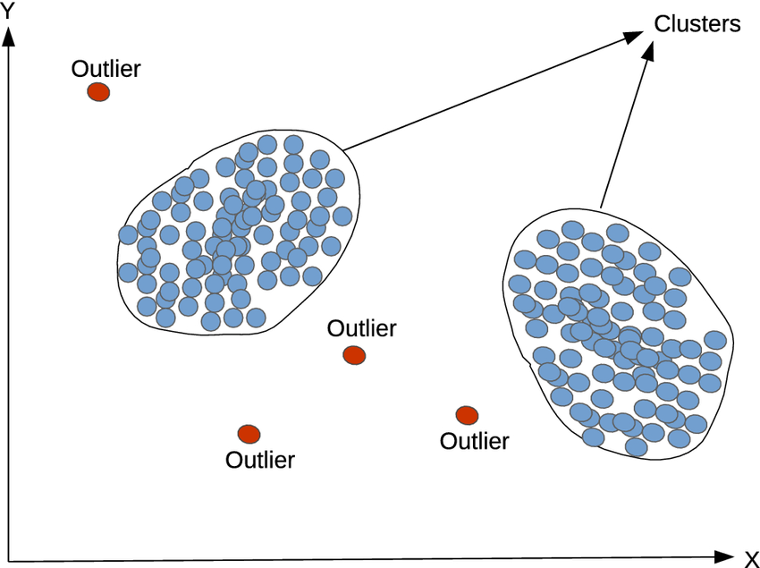

Outliers

Slide 11
Outlier Detection
Numerical columns outlier I used IQR to remove the outlier from the numerical columns by taking lower and upper bound 1.5
The values which is below or above the 1.5 bonds are detected as outlier

Slide 12
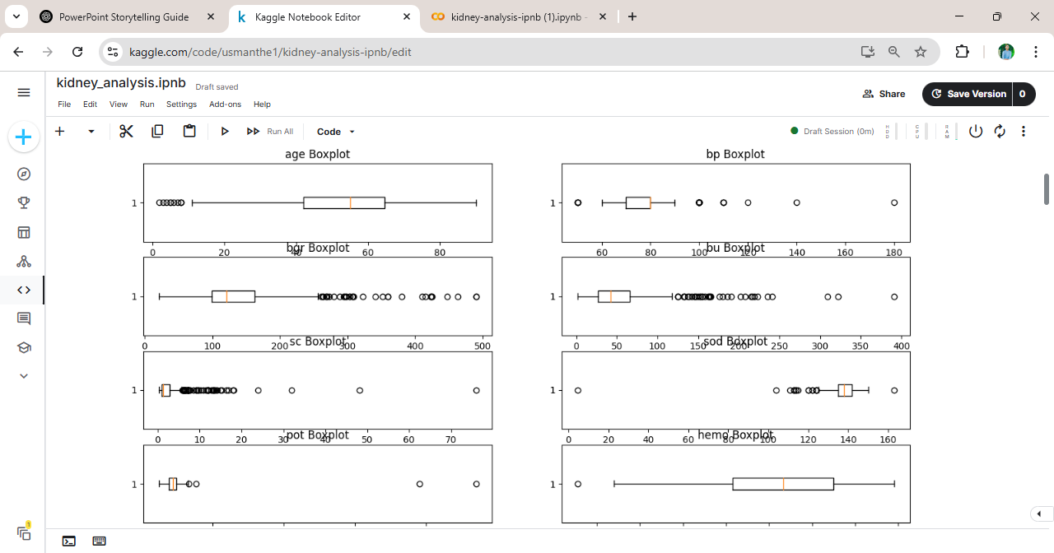
Visual Representation of Outlier before removing

Slide 13
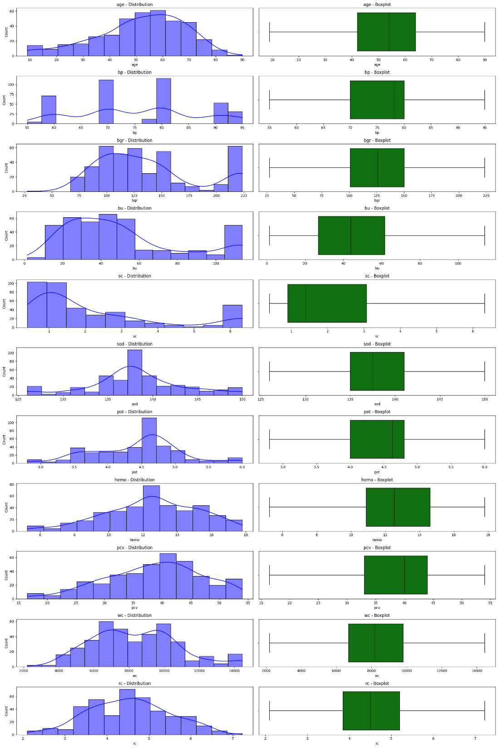
Visual representation after removing numerical outlier

Slide 14
Categorical outlier Detection
Info: categorical columns outlier are :
Rare Categories – Categories that appear very few times in the dataset
Misspelled Values – Variations of the same category due to typos (e.g., "Diabetes" vs. "Diabtes").
Extra Spaces – Leading or trailing spaces that cause duplicate-looking values (e.g., "High " vs. "High").
Unknown Operators & Symbols – Unexpected values like "??", "--", or "N/A" that are not valid categories.

Slide 15
Removing the categorical outlier
First i remove the all Misspelled Values , Extra Spaces , Unknown Operators & Symbols . By using the code by pandas library.
Then group all the rare values from all the categorical columns in one column and remove that column This is also done by the code by using pandas library

Slide 16
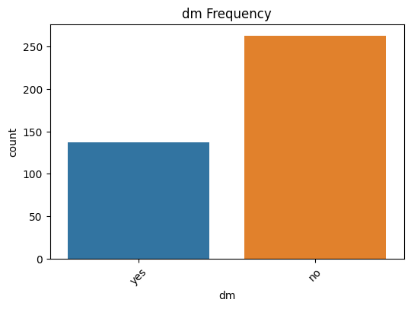
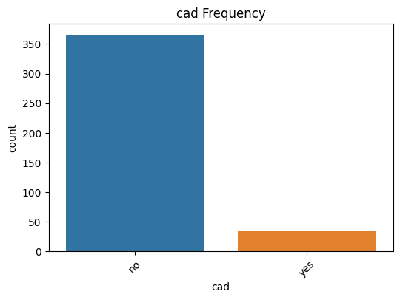
Visual representation of categorical columns

Slide 17
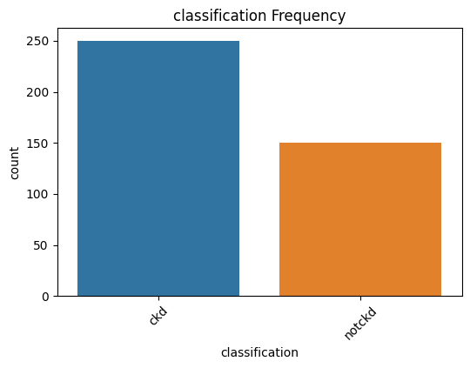
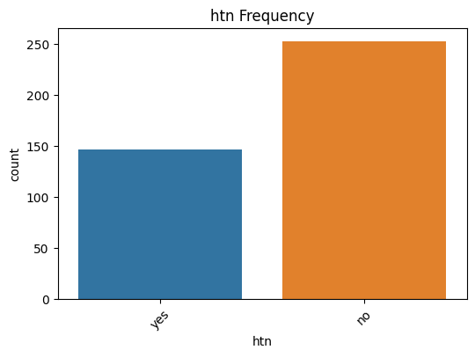
Continue …..

Slide 18
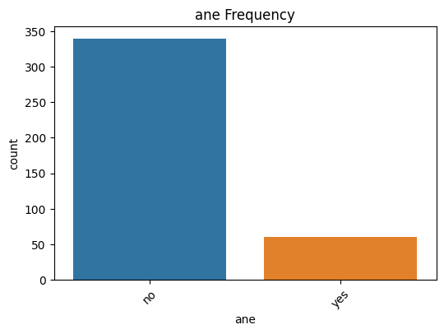
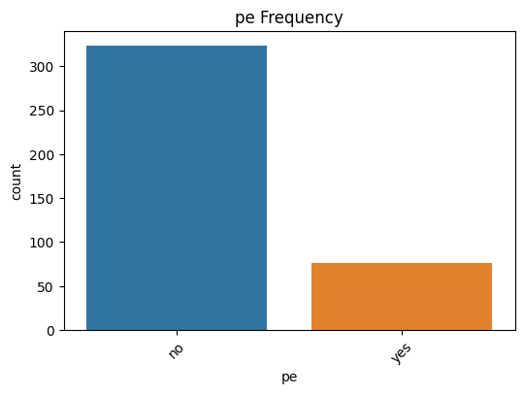
Continue….

Slide 19
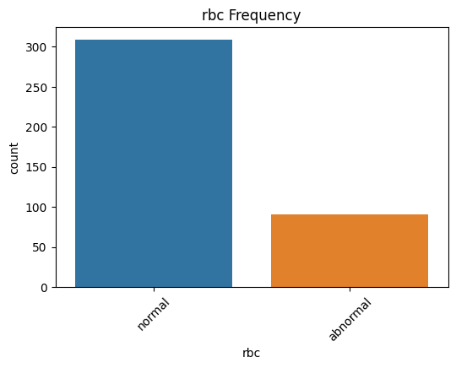
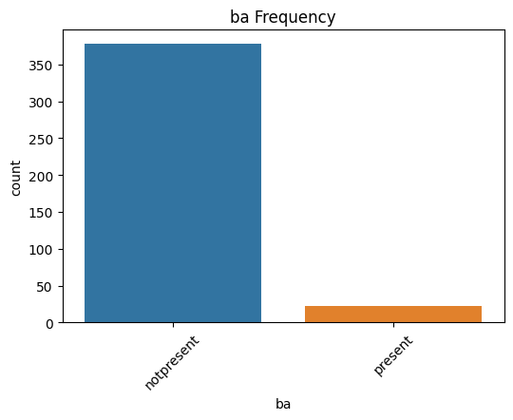
Continue….

Slide 20
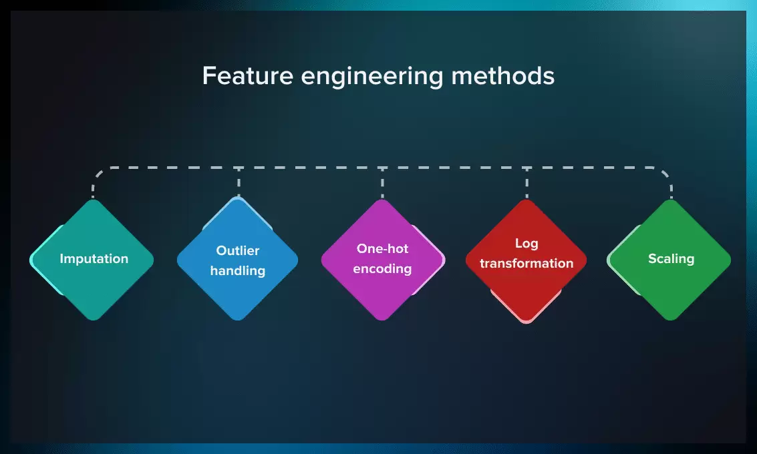

Feature Engineering

Slide 21
Feature Engineering
In this section I drop the unimportant columns which is not important for my analysis like col_drop = ['dm', 'cad' , 'appet‘ , ‘id’ ].
I also change the data type of some column which need to modify like in my data set AGE column has data type float but all data contain num which is not in decimal form so modified to int .
age (float) coverted to int .

Slide 22
Continue…..
Numerical columns which need to standardization are standerdized. E.g. Age , bp , pcc , bgr , sod , pot, hemo , pcv, wc , rc , etc.
Categorical columns in my data set contain (yes / no ) (normal / abnormal ) (KCD / not KCD)………… so apply the label encoder and convert it to 0 or 1 category .
Both Numerical and Categorical columns are standardized or encoded by using SCIKIT LEARN LIBRARY

Slide 23

Insights from the Analysis

Slide 24
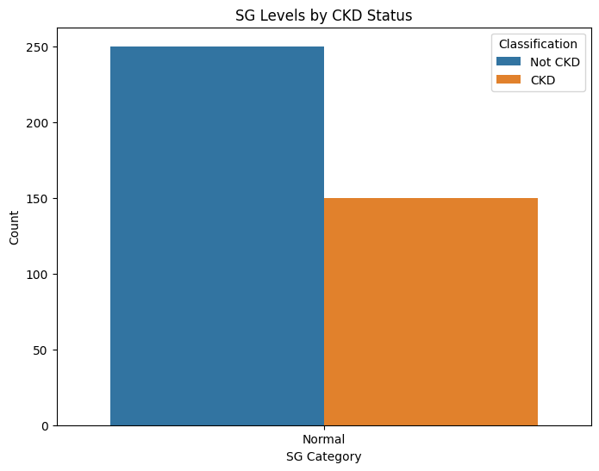
Classification CKD & NOT CKD by SG BP & AGE level
Specific Gravity (SG) in Kidney Function
SG measures urine concentration and kidney’s ability to concentrate or dilute urine
Normal range: 1.005 – 1.030
Low SG → Kidney dysfunction, excessive fluid intake
High SG → Dehydration, concentrated urine, possible kidney issues

Slide 25
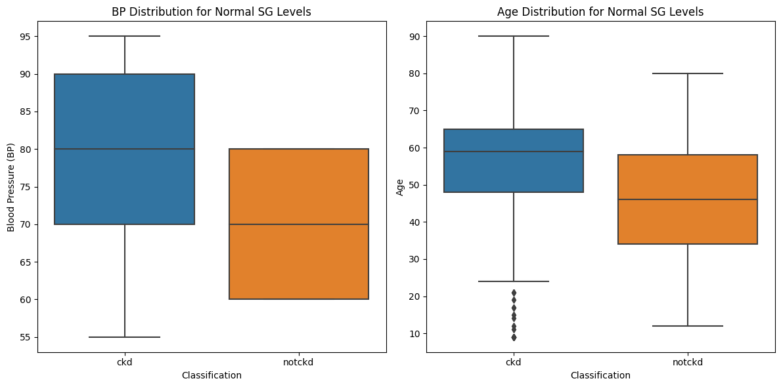
Continue….

Slide 26
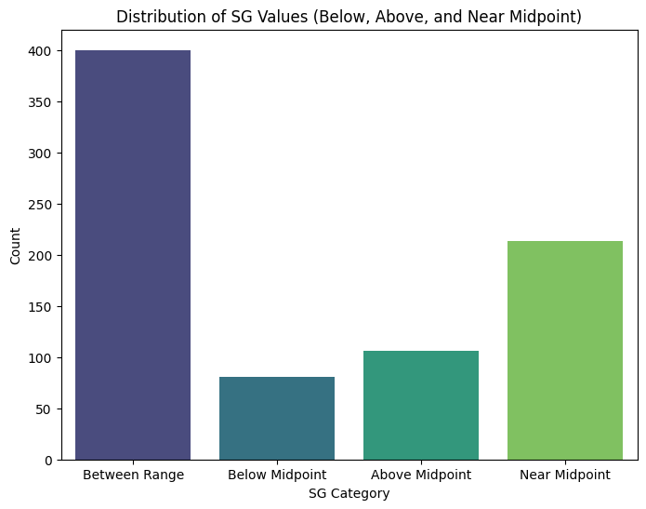
Continue…..
INFO
People with SG between 1.005 and 1.035 is = 400.
People with SG below the midpoint (1.02) is = 213
People with SG above the midpoint (1.02) = 81 People with SG near the midpoint (1.02): 106

Slide 27

Classification CKD & NOT CKD by AL BP & AGE level
Albumin (AL) in Kidney Function
AL measures the presence of albumin (protein) in urine, indicating kidney health.
Normal: No or trace amounts (normal < 30)
High AL → Kidney damage, proteinuria, possible chronic kidney disease (CKD)

Slide 28

Continue….

Slide 29
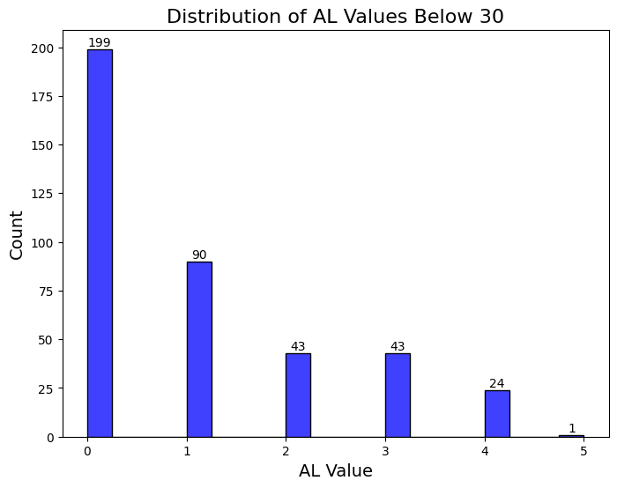
Continue…..

Slide 30
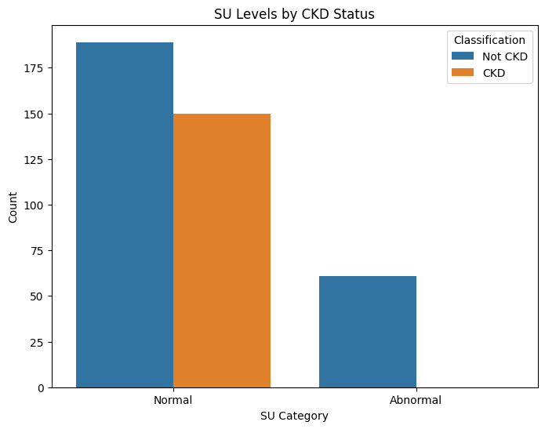
Classification CKD & NOT CKD by SU BP & AGE level
Sugar (SU) in Kidney Function SU measures glucose levels in urine, which can indicate abnormal kidney filtration.
Normal: No glucose detected
High SU → Possible diabetes, kidney dysfunction, or glucose reabsorption issues

Slide 31
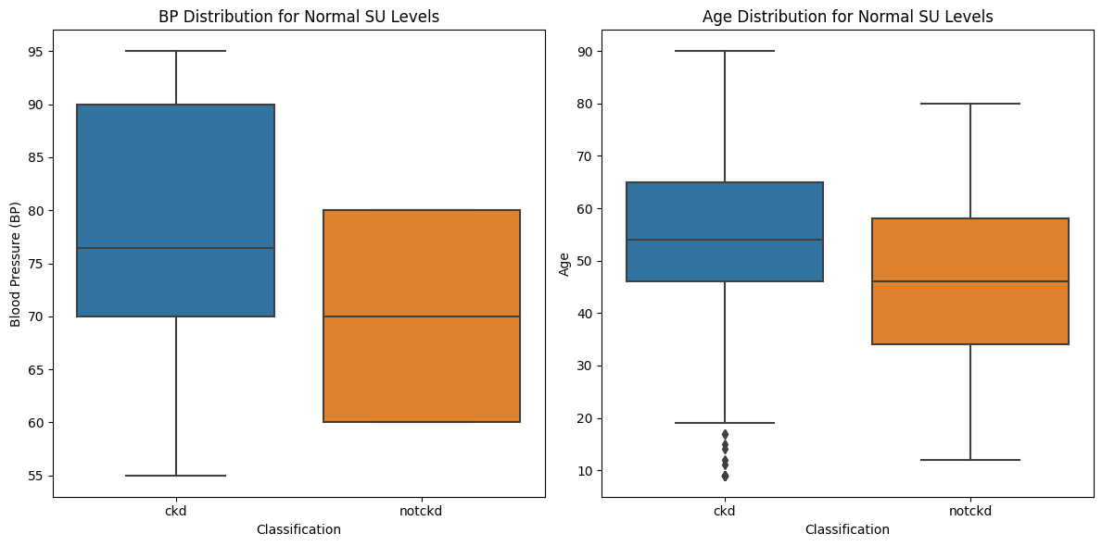
Continue…..

Slide 32
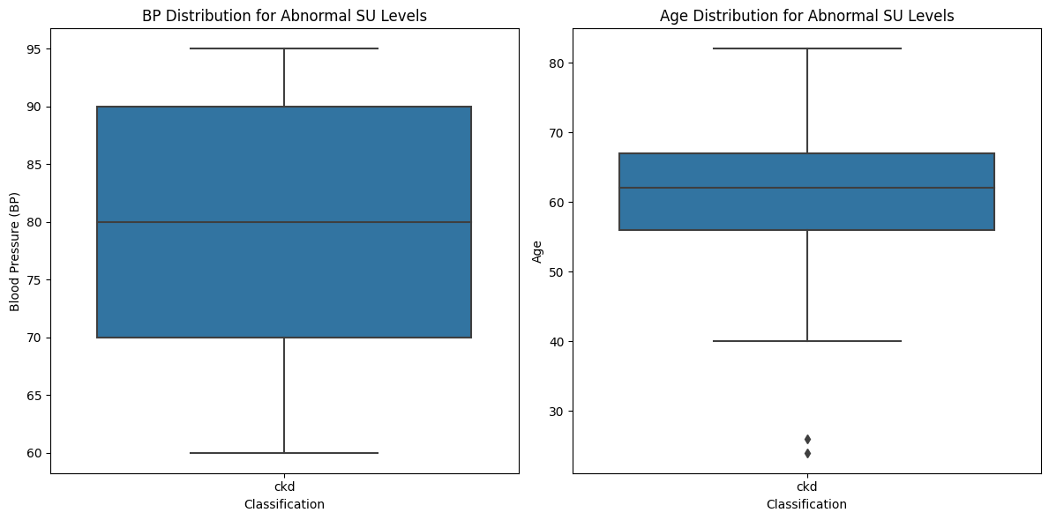
Continue….

Slide 33
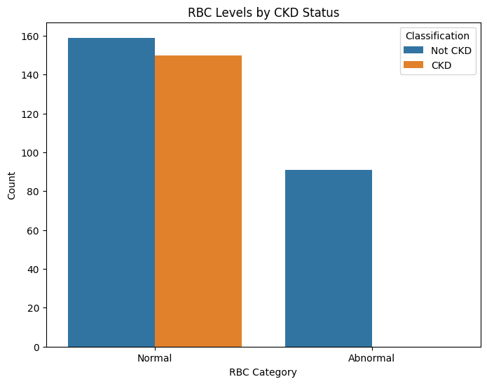
Classification CKD & NOT CKD by RBC BP & AGE level
Red Blood Cells (RBC) in Kidney Function RBC in urine indicates kidney health and possible bleeding in the urinary tract.
Normal Range: 0-2 RBCs per high power field (HPF)
High RBC → Infection, kidney stones, or kidney disease
Chronic kidney disease (CKD) if the RBC is below normal range

Slide 34
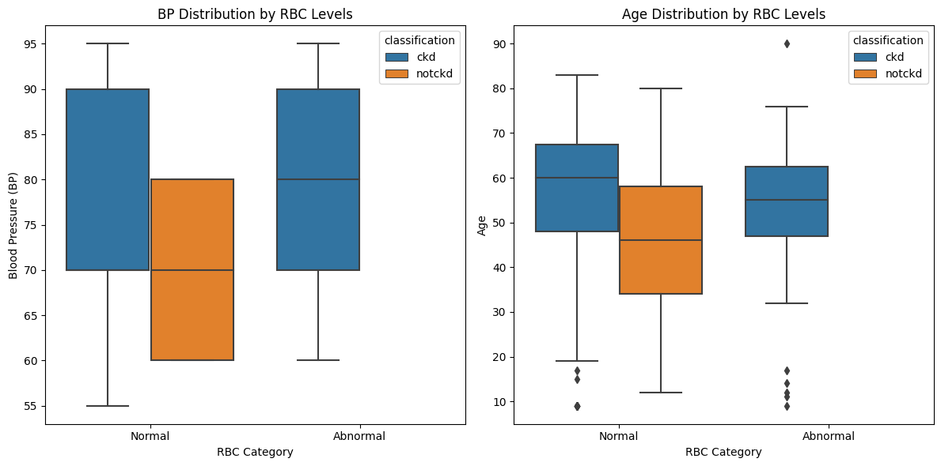
Continue….

Slide 35
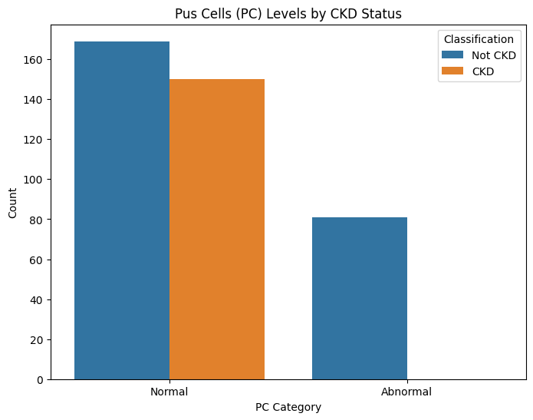
Classification CKD & NOT CKD by PC BP & AGE level
Pus Cells (PC) in Kidney Function
PC (white blood cells in urine) indicates infection or inflammation in the urinary tract or kidneys.
Normal Range: 0-5 pus cells per high power field (HPF)
High PC → Urinary tract infection (UTI), kidney infection, or inflammation

Slide 36
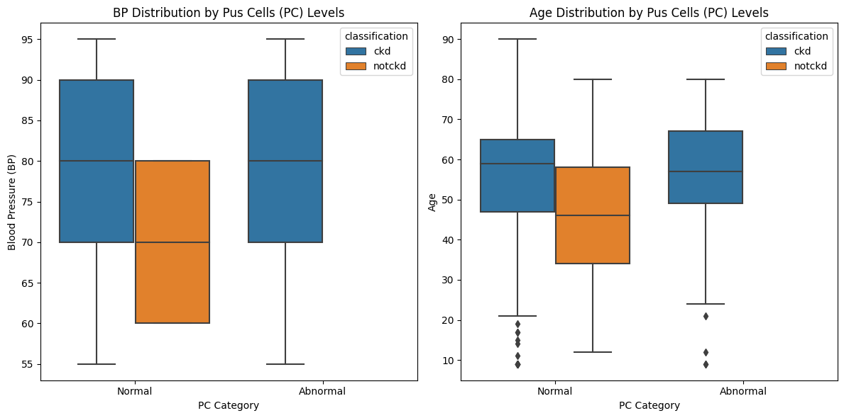
Continue….

Slide 37
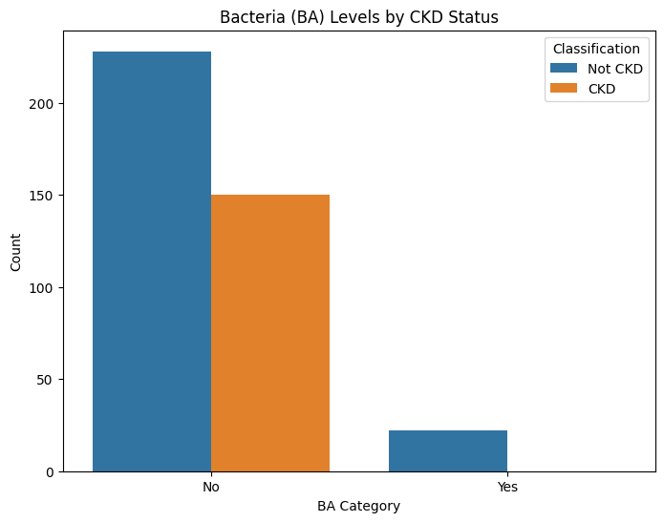
Classification CKD & NOT CKD by BA BP & AGE level
Bacteria (BA) in Kidney Function BA indicates the presence of bacteria in urine, which may signal an infection.
Normal: No bacteria present
High BA → Possible urinary tract infection (UTI), kidney infection, or contamination during sample collection

Slide 38

Continue…..

Slide 39
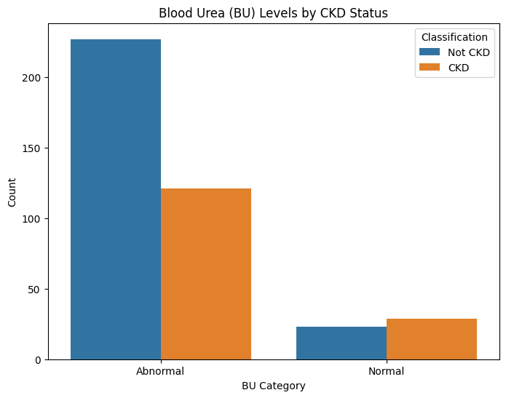
Classification CKD & NOT CKD by BU BP & AGE level
Blood Urea (BU) in Kidney Function BU measures urea levels in the blood, indicating kidney efficiency in waste removal.
Normal Range: 7 – 20 mg/dL
High BU → Kidney dysfunction, dehydration, high protein intake
Low BU → Liver disease, malnutrition, overhydration

Slide 40
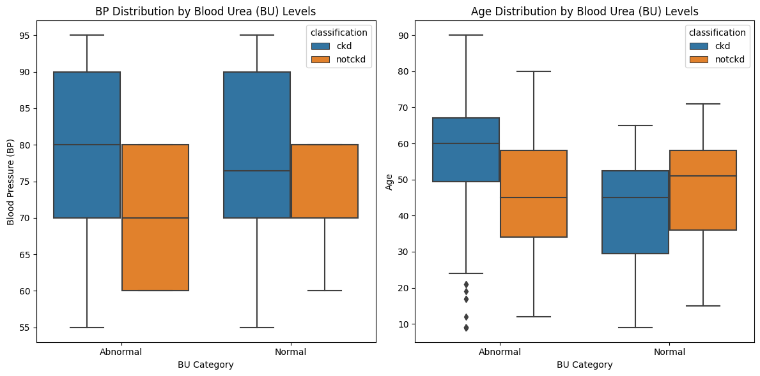
Continue…

Slide 41
Final Conclusion
Specific Gravity (SG): Lower SG levels indicate kidney dysfunction, while higher SG suggests dehydration.
Albumin (AL): High AL levels are strongly associated with CKD due to protein leakage in urine.
Sugar (SU): Presence of glucose in urine suggests potential kidney damage, often linked to diabetes.
Red Blood Cells (RBC): Abnormal RBC levels indicate kidney infections or chronic kidney disease.

Slide 42
Continue…
Pus Cells (PC): High PC levels suggest inflammation or urinary tract infections, often linked to CKD.
Bacteria (BA): Presence of bacteria indicates urinary infections, which can worsen kidney health.
Blood Urea (BU): Elevated BU suggests kidney dysfunction and waste retention.

Slide 43
Data Trends & Observations
A significant number of patients with low SG, high AL, high SU, and high BU were classified as CKD-positive.
BP and Age play a crucial role in kidney disease, with older individuals and those with hypertension showing higher CKD rates.

